Slide 1
Spring MVC
Presented By-
Krati Tamrakar

Slide 2

What is Spring MVC ?
Spring MVC Architecture
Workflow in Spring MVC
Spring MVC Configuration
Important Annotations
Summary
Outlines :-

Slide 3
What's Spring MVC ?
Spring MVC framework is a robust Model view controller design pattern which helps us to develop a loosely coupled web application.
Open Source developed and maintained by Interface21, recently purchased by VMWare.
It is built on the top of servlet API.
Spring MVC is a sub-framework of Java Spring Framework.
Made to simplify the writing and testing of Java web applications
Fully integrates with the Spring dependency injection (Inversion of Control) framework

Slide 4
Spring MVC Architecture-
1. Model: A model contains the data of the application. A data can be a single object or a collection of objects.
It generally includes POJO in the form of business objects.
2. View: A view represents the provided information in a particular format. It will render application data on UI.
Generally, JSP+JSTL is used to create a view page.
Although spring also supports other view technologies such as Apache Velocity, Thymeleaf and FreeMarker.
3. Controller: A controller contains the business logic of an application. It takes care of processing user request and calling back-end services.
Here, the @Controller annotation is used to mark the class as the controller.

Slide 5
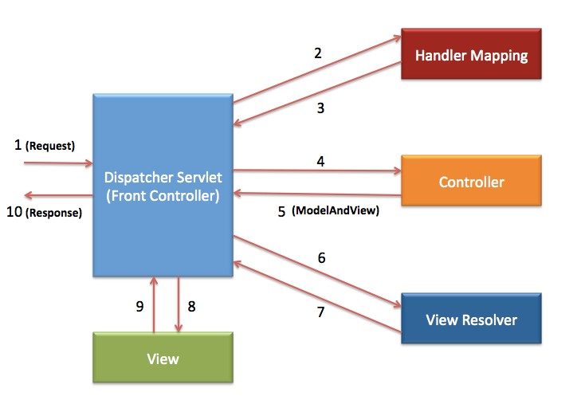
Spring MVC Workflow :-

Slide 6
Spring DispatcherServlet :- The DispatcherServlet is responsible for handling incoming HTTP requests and delegating them to the appropriate controller method for processing.
The DispatcherServlet is the front controller in Spring web applications.
It’s used to create web applications and REST services in Spring MVC.
In a traditional Spring web application, this servlet is defined in the web.xml file.
It receives all the HTTP requests and delegates them to controller classes.
The Spring Boot autoconfiguration registers and configures the DispatcherServlet automatically.
In most cases, applications have only a single DispatcherServlet with the context-root URL(/), all requests coming to that domain will be handled by it.

Slide 7
Create Your First Spring MVC Application
Step 0: Setup your project with maven use the required archetype to get the required folders directory and configure the server with your project.
Step 1: Load the spring jar files or add the dependencies if Maven is used. Add the following dependencies in pom.xml.
Step 2: Create the Controller Class.
Step 3: Provide the name of the controller in the web.xml
Step 4: We have to define the bean in a separate XML file. We have specified the view components in this file. It is located in the WEB-INF directory.
Step 5: Use JSP to display the message.
Step 6: Start the server and run the project.

Slide 8
Spring MVC Annotations
Defining a Controller:
There’re two different annotations we can use for our controller based on its type:
1. @Controller: @Controller annotation is specialized component annotation which is used to annotate classes at Presentation layer. It is widely used in Spring MVC applications.
@Controller
public class MyController {
…
}
2. @RestController: This annotation is useful for annotating our RESTful controllers. This annotation is itself annotated with both @Controller and @ResponseBody annotations.
@RestController
public class MyRestController {
...
}

Slide 9
Spring MVC @RestController annotation example
Spring MVC @RestController annotation is used declare Controller in Spring MVC.
It was introduced in Spring 4.
When you use @RestController, you don’t need to define @ResponseBody.
@RestController = @Controller + @ResponseBody
@RestController
public class CountryController {
@RequestMapping(value = "/countries", method = RequestMethod.GET,headers="Accept=application/json")
public List getCountries()
{
List listOfCountries = new ArrayList();
listOfCountries=createCountryList();
return listOfCountries;
}

Slide 10
Spring Component, Service, Repository Annotations :-
There is three most important annotation in spring i.e. @Component, @Service and @Repository. These annotations are used declare appropriate bean based on its nature.
1. @Component:
@Component is generic annotation for bean definition and registers with application context.
2. @Service :
@Service is specialized component annotation which is used to annotate classes which belongs to service layer.
3. @Repository :
@Repository annotation is specialized component annotation which is used to annotate classes at DAO layer. It also makes unchecked exception eligible for conversion into Spring DataAccessException.

Slide 11
@ComponentScan - responsible for scanning each and every classes in sub packages. And find that bean in sub package.
@autoconfiguration -

Slide 12
Request-Handling Annotations: the annotations which are used for handling HTTP requests.
@RequestMapping: We use this annotation to map the web request methods in the Spring MVC Controller.
We can also customize it using its available attributes:
method: denotes one the HTTP request methods – GET, POST, PUT, PATCH, DELETE
value: the mapped URL
params: filters the request based on the HTTP parameters
headers: filters the request based on the HTTP headers.
produces: defines the media type of the HTTP responses
consumes: specifies the media type of the HTTP request
@Controller
@RequestMapping("/hello-world")
class MyController {
@RequestMapping(value = "/message", method = RequestMethod.GET)
String message()
{ return "Hello World!"; }
}

Slide 13
The following annotations are used to handle different types of incoming HTTP request methods: -
@GetMapping- The GET HTTP request is used to get single or multiple resources.
@PostMapping- The POST HTTP method is used to create a resource.
@PutMapping- The PUT HTTP method is used to update the resource.
@PatchMapping- The PATCH HTTP method is used when you want to apply a partial update to the resource.
@DeleteMapping- The DELETE HTTP method is used to delete the resource.

Slide 14
Spring MVC RequestMapping example :
@RequestMapping is used to define mapping of web request to appropriate handler method or class.
It can be used at method level or class level.
@RestController
@RequestMapping(value = "/countries")
public class CountryController {
@RequestMapping(method = RequestMethod.POST, headers = "Accept=application/json")
public Country addCountry(@RequestBody Country country) {
return countryService.addCountry(country);
}
@RequestMapping(method = RequestMethod.PUT, headers = "Accept=application/json")
public Country updateCountry(@RequestBody Country country) {
return countryService.updateCountry(country);
}
}

Slide 15
2. @RequestParam:- With this annotation, we can bind an HTTP request parameter to the method parameter. Optionally, we can also provide a default value. For the missing value of the request parameter, the default value is used:
@GetMapping("/message")
String message(@RequestParam(defaultValue = "Sam") String userName) {
return "Hello " + userName;
}
3. @PathVariable :- The @PathVariable annotation is used to extract the value of the URL template. It is passed within the parameters of the handler method.
@GetMapping("/message/{userName}")
String message(@PathVariable String userName) {
...
}

Slide 16
Response-Handling Annotations:
@ResponseBody: Similar to the @RequestBody, we have a @ResponseBody annotation. When we annotate a method with this annotation, Spring treats the result of this method as the response itself.
@GetMapping("/message")
@ResponseBody
String message() {
return "Hello World!!";
}
2. @RespnseStatus: With this, we can map the desired HTTP response status to the methods in our controller.
@ExceptionHandler(UserAccessDeniedException.class)
@ResponseStatus(HttpStatus.FORBIDDEN)
void onUserAccessDeniedException(UserAccessDeniedException exception) {
...
}

Slide 17
Spring MVC @ModelAttribute annotation - Spring @ModelAttribute annotation is used to bind a method parameter or method return value to a named model attribute which further can be used in the view page.
It can be used either at the method level or method parameter level.
1. @ModelAttribute at a Method Level
We can use this annotation at the method level to specify that this method may add one or model attributes.
@PostMapping("save")
@ModelAttribute("user")
public String save(User user, Model model) {
model.addAttribute("user", user);
return "response";
}
2. @ModelAttribute at a Method Argument
We can use it with the method argument that indicates the argument should be retrieved from the model. If the argument is not present then first it should be instantiated and then added to the model.
@PostMapping("save")
public String save(@ModelAttribute("user") User user, Model model) {
model.addAttribute("user", user);
return "response";
}

Slide 18
Spring MVC interceptor :-
Spring Interceptor is a concept that is similar to servlet filter.
In Spring, When a request is sent to spring controller, it will have to pass through interceptors(0 or more) before being processed by controller.
It is only applied to requests that are sending to a controller.
In short, It intercept requests and process them. They help to avoid repetitive handler code such as validation, logging and authorization checks etc.
If you want to preprocess or postprocess on incoming request, then you can use Spring MVC interceptor to do it.

Slide 19
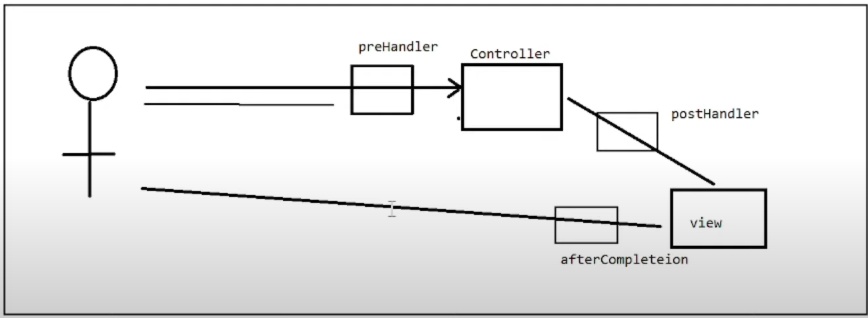
HandlerInterceptor – an interface, which must be implemented by the Spring interceptor classes, has the following three methods.
preHandle(…) – just before the controller
postHandle(…) –just after the controller
afterCompletion(…) –just before the response sent to view

Slide 20
Summary :-
Separate roles
Powerful Configuration
Rapid development
Reusable business code
Easy to test
Flexible Mapping

Slide 21
Thank You !!

